Slide 1


Miljenko Cvjetko
Software Engineer Components Team
miljenko.cvjetko@xamarin.com
.net on Linux dotnet.core Mono CoreCLR ASP.net
Notes:
1

Slide 2
Historical 01
.net on Linux
Since 2001
Mono project
Open Source implementation of Microsoft’s .net framework
ECMA Standard
Subset of Microsoft’s .net framework
Set of frameworks, tools (commandline, IDE)
Xamarin
Notes:
2 -

Slide 3
Historical 02
Motivation
Cloud – Azure
IoT
Cost and performance
Size – start small, opt in only what is needed
ASP.net team
3 years ago
Target platforms: not only Windows
Size of classic ASP.net – 200 MB
Influence of Node, Ruby, Go
Notes:
2 -

Slide 4
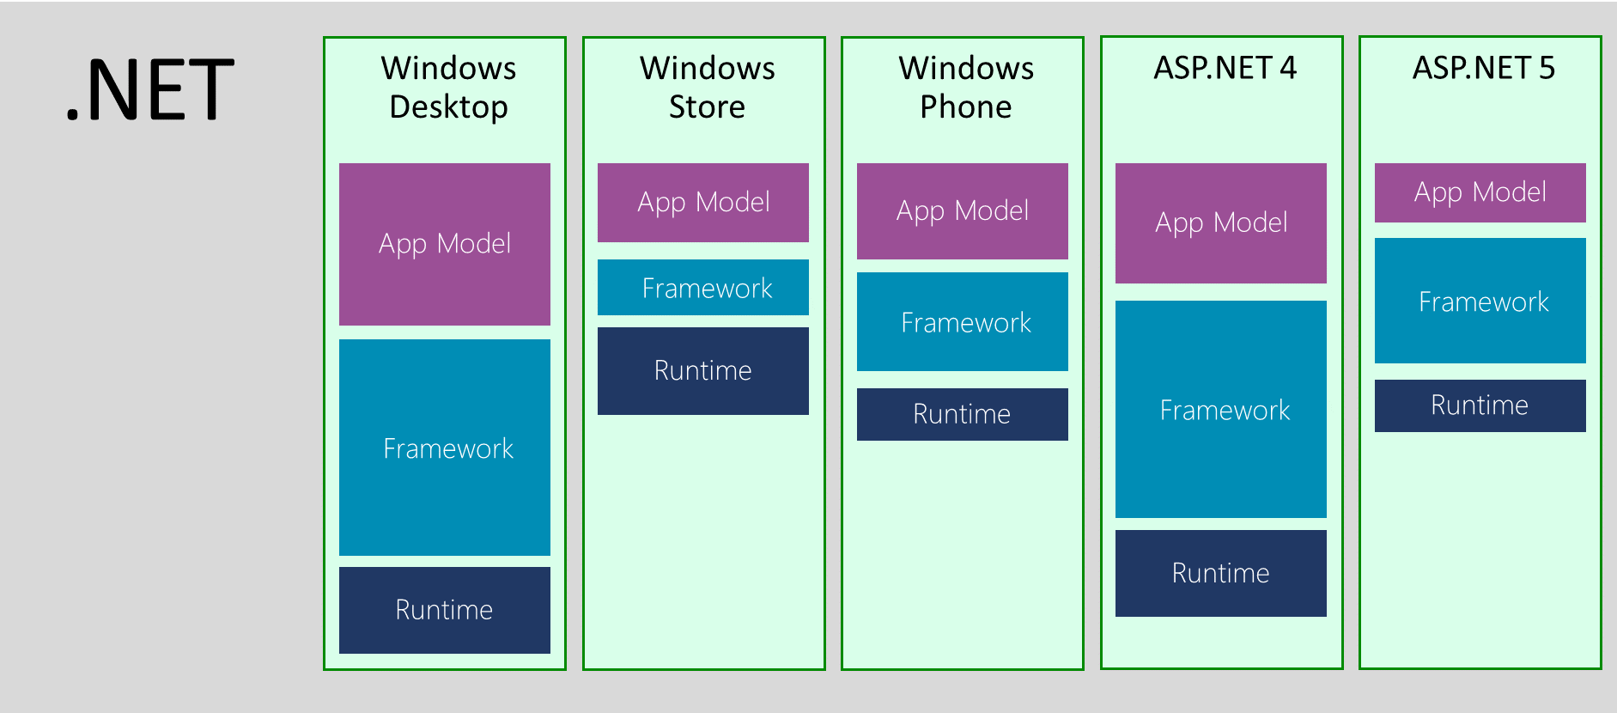
Historical 03
Notes:
2 -

Slide 5
Historical 04
fragmentation
Different Teams => Different Products
Historical reasons
Desktop
where everything started
Size and performance were not priority #1
Server
Cloud, Mobile, IoT
Xamarin Solution
Least Common Denominator - Silverlight Profile (Moonlight)
Notes:
2 -

Slide 6
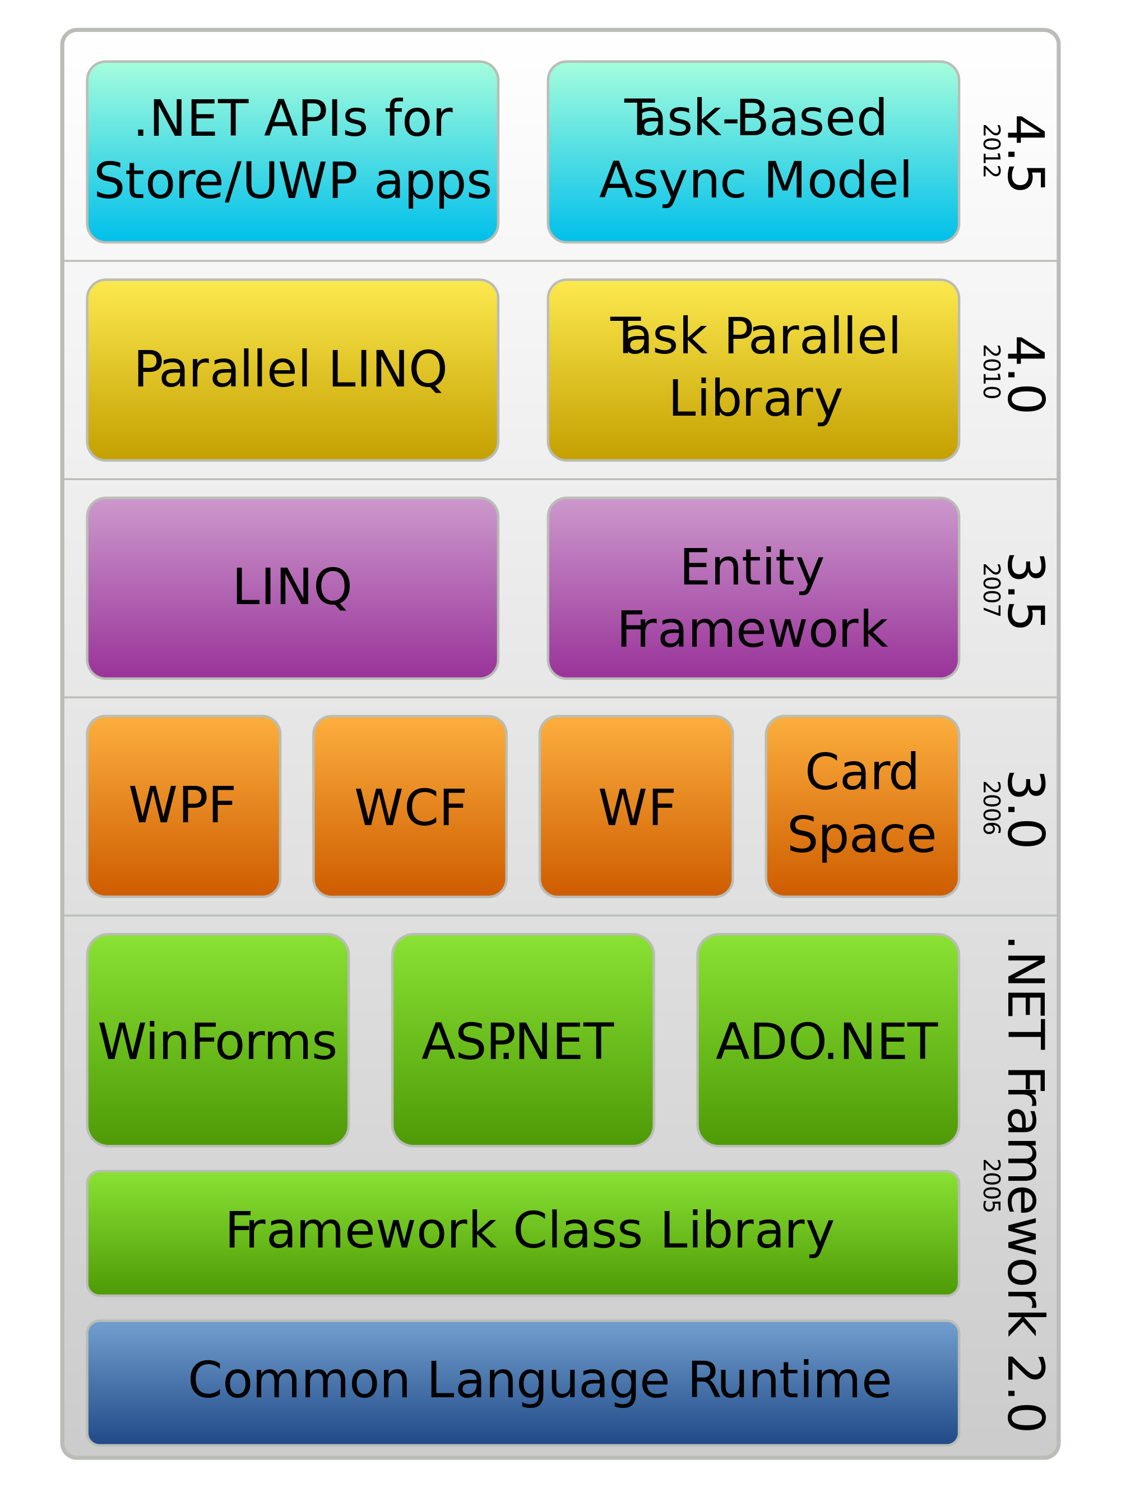
.net Framework (dotnet, netfx)
.net components (Architecture)
Runtime CLR Common Language Runtime
Runtime Services GC Garbage Collector, Security
CLI Common Language Infrastructure
Framework Libraries Base Class Libraries BCL
Compilers C#, VB, F#
! Windows implementation
Mono
Notes:
2 -

Slide 7
.net Core Motivation 01
Influence of modern technologies
Web Node, Ruby Size, Performance, Modularity, Scalability Package Management, Tools (scripting, command line)
Mobile Xamarin.Android, Xamarin.iOS Ahead of Time Compilation AoT - .net Native, Ryu JIT Size, Performance
Xplat
Target as much platforms as posible
Notes:
2 -

Slide 8
.net Core Motivation 02
PACKAGE_MANAGER=apt-get
#PACKAGE_MANAGER=yum
#where mylang is some language/runtime
$PACKAGE_MANAGER install mylang
#write or generate a foo.fb hello world program
#compiles and runs foo
mylang foo
Notes:
2 -

Slide 9
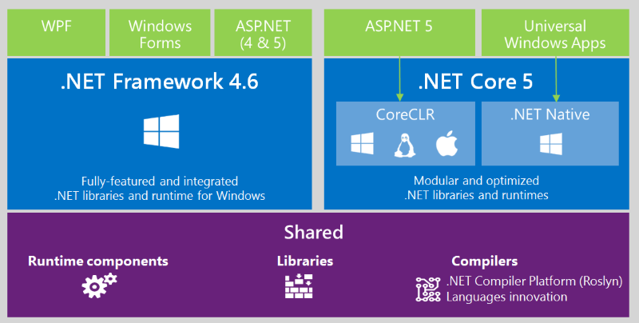
.net vs .net Core 01
Notes:
2 -

Slide 10
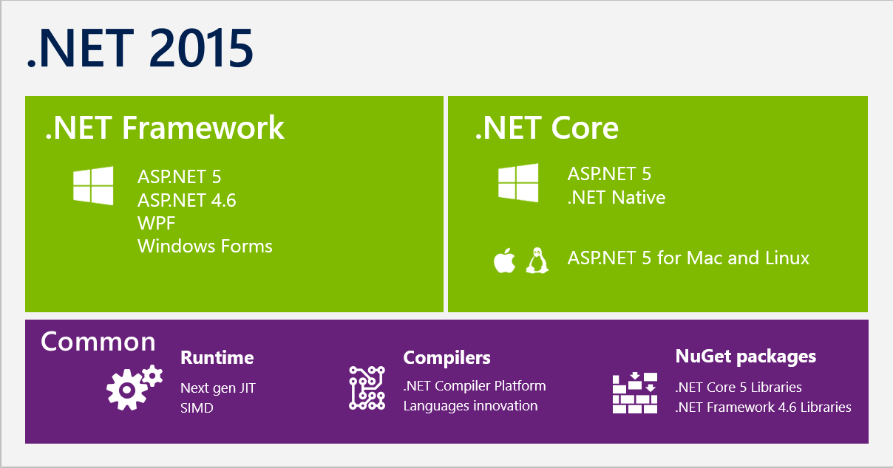
.net vs .net Core 02
Notes:
2 -

Slide 11
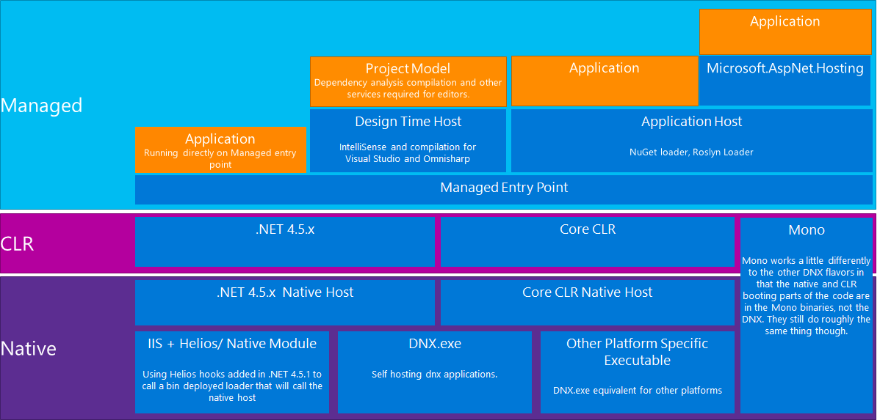
.net vs .net Core 03
Notes:
2 -

Slide 12
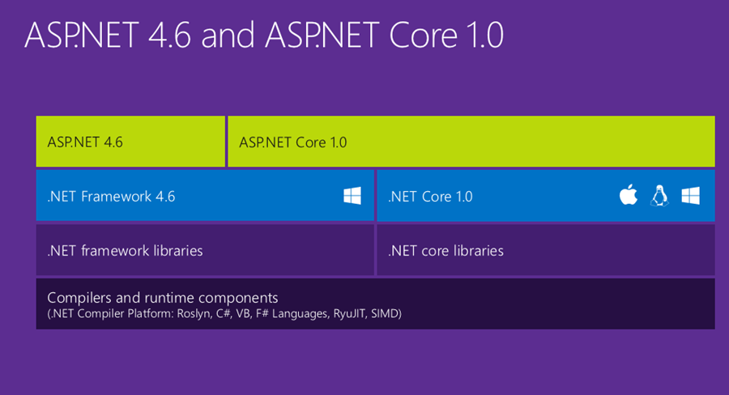
.net vs .net Core 04
Notes:
2 -

Slide 13
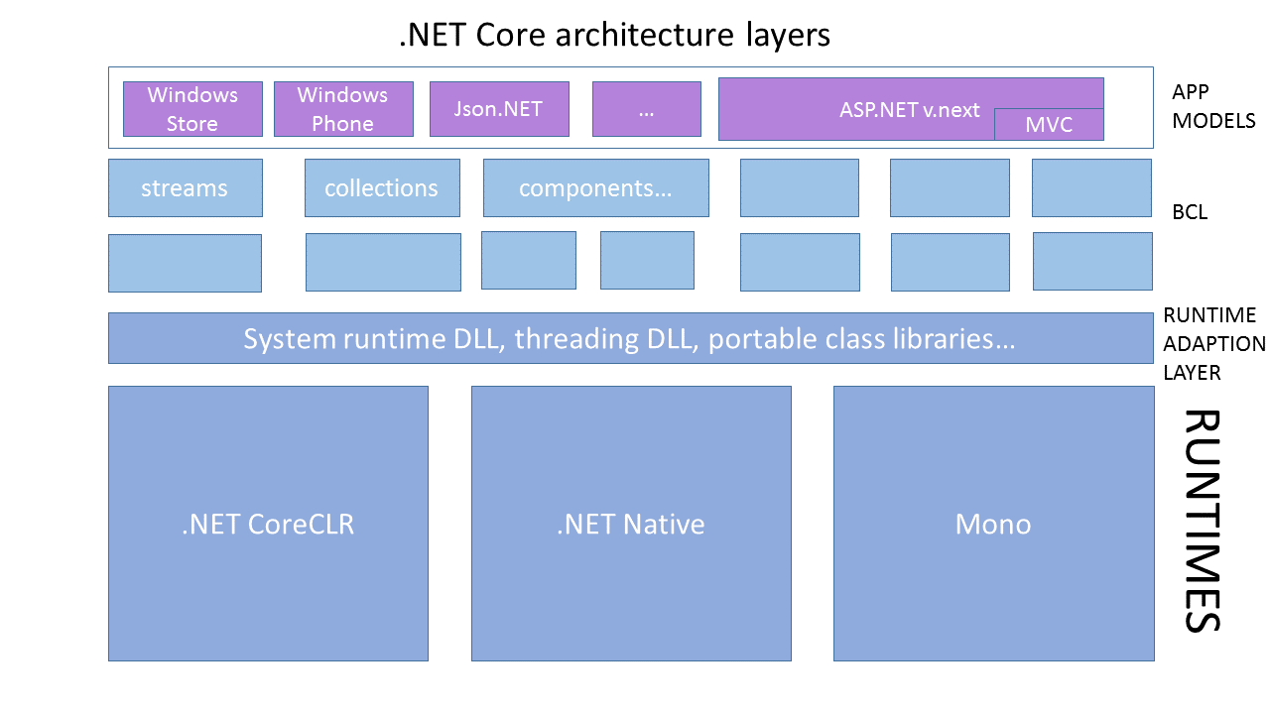
.net vs .net Core 05
Notes:
2 -

Slide 14
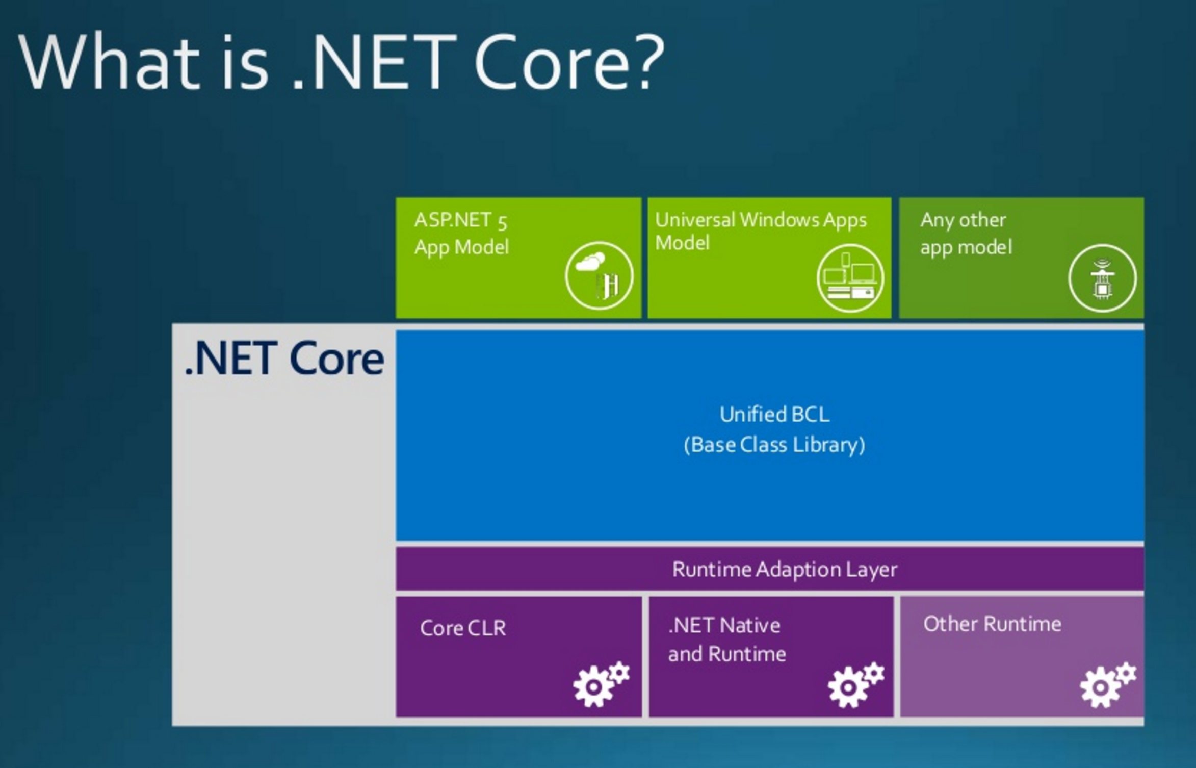
.net vs .net Core 06
Notes:
2 -

Slide 15
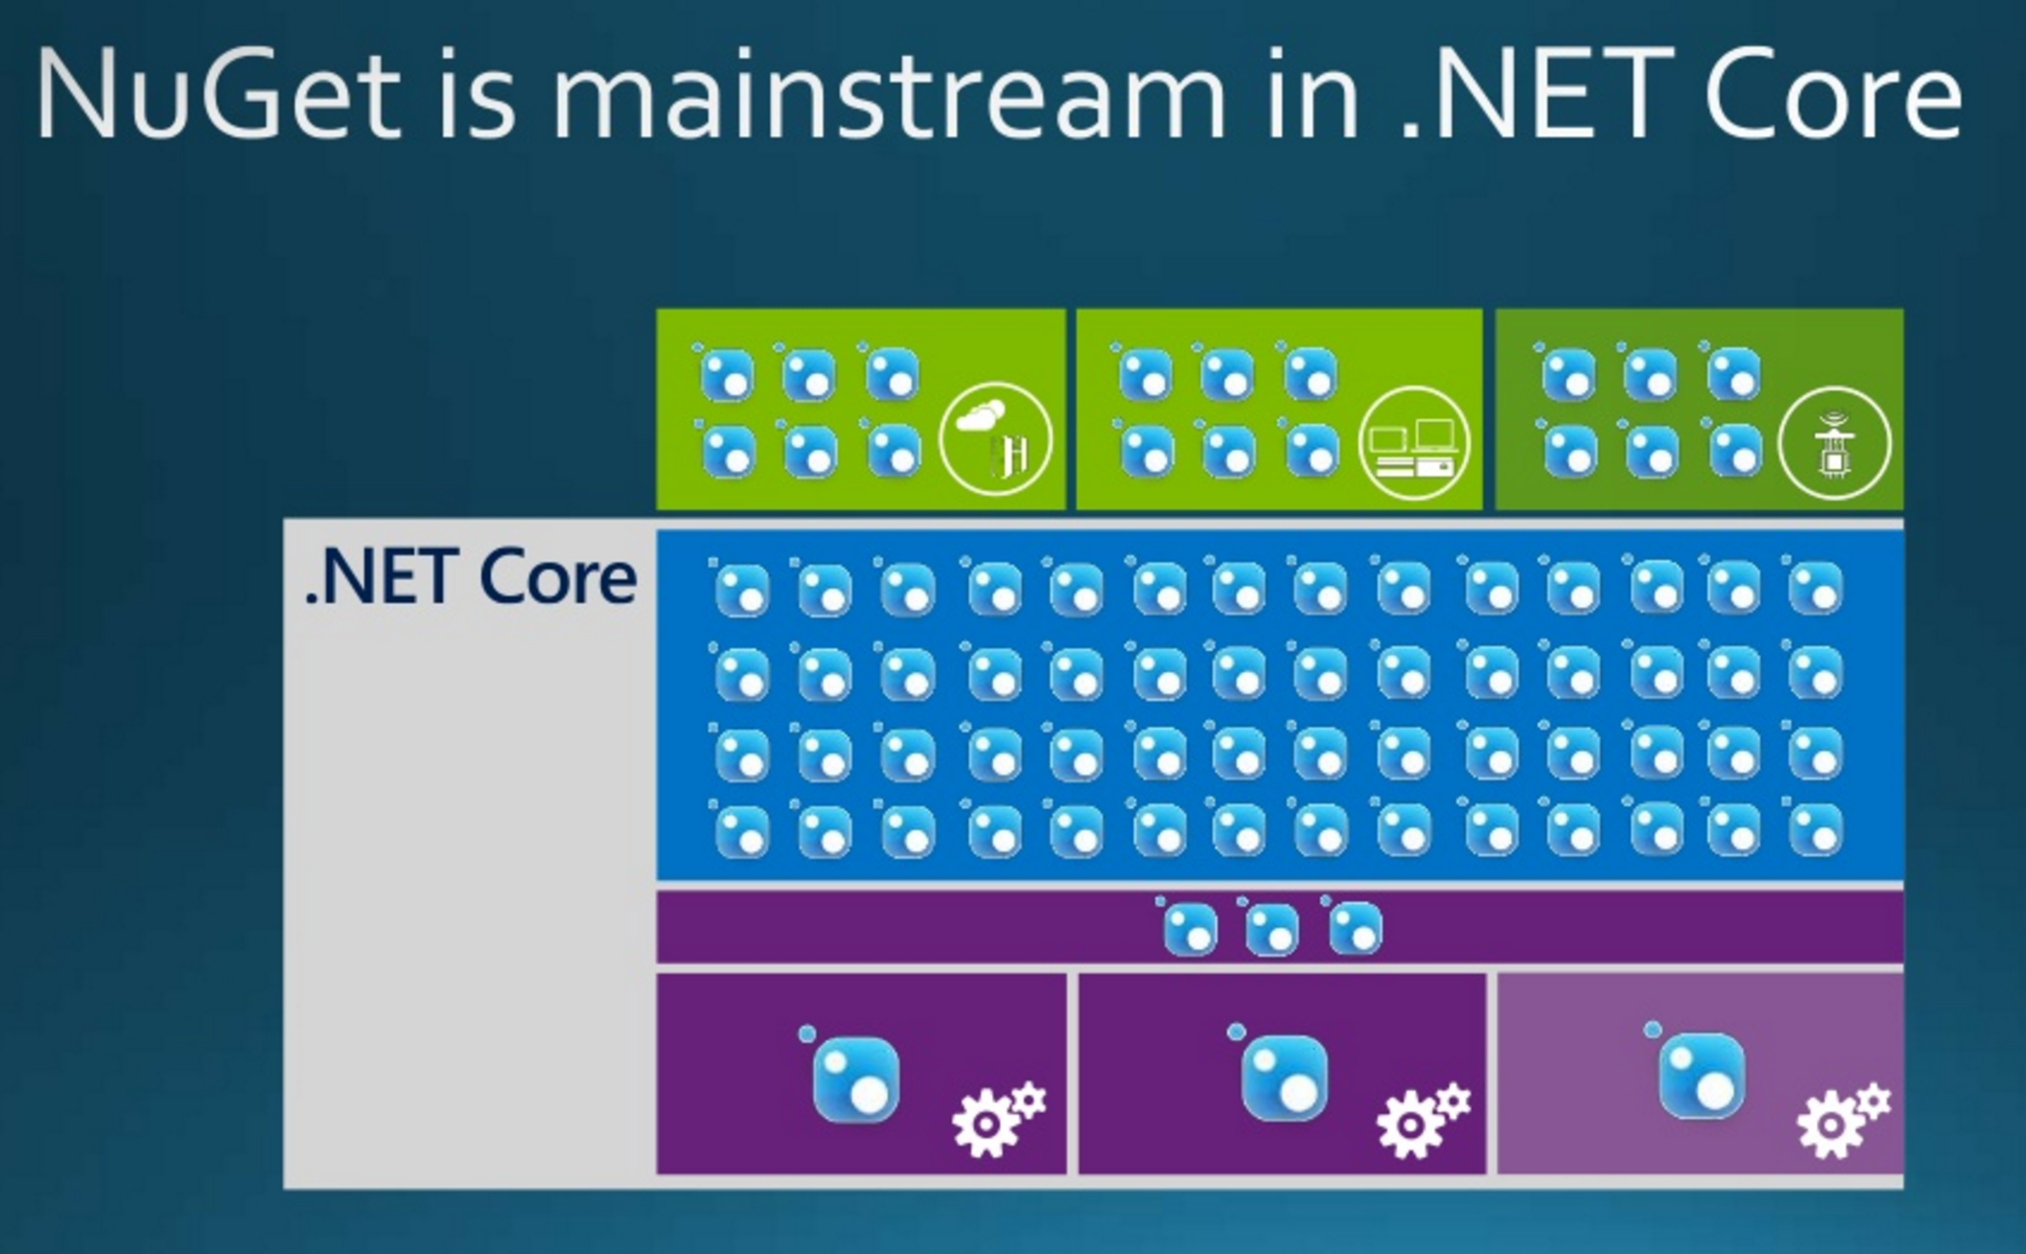
.net vs .net Core 07
Notes:
2 -

Slide 16
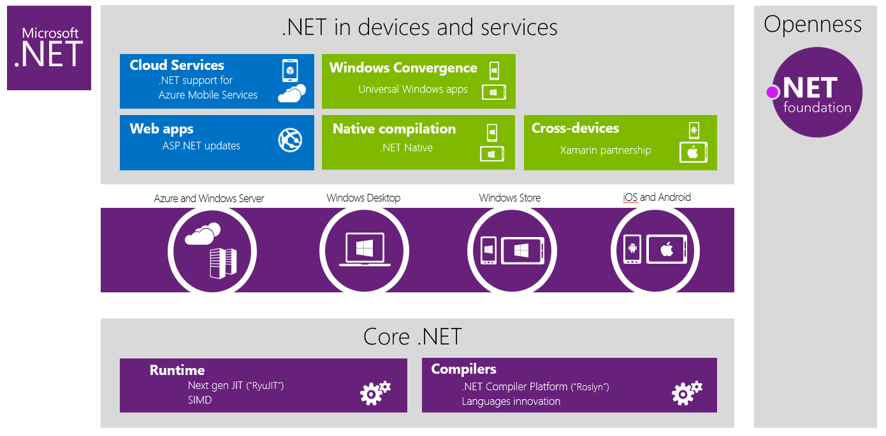
.net vs .net Core 08
Notes:
2 -

Slide 17
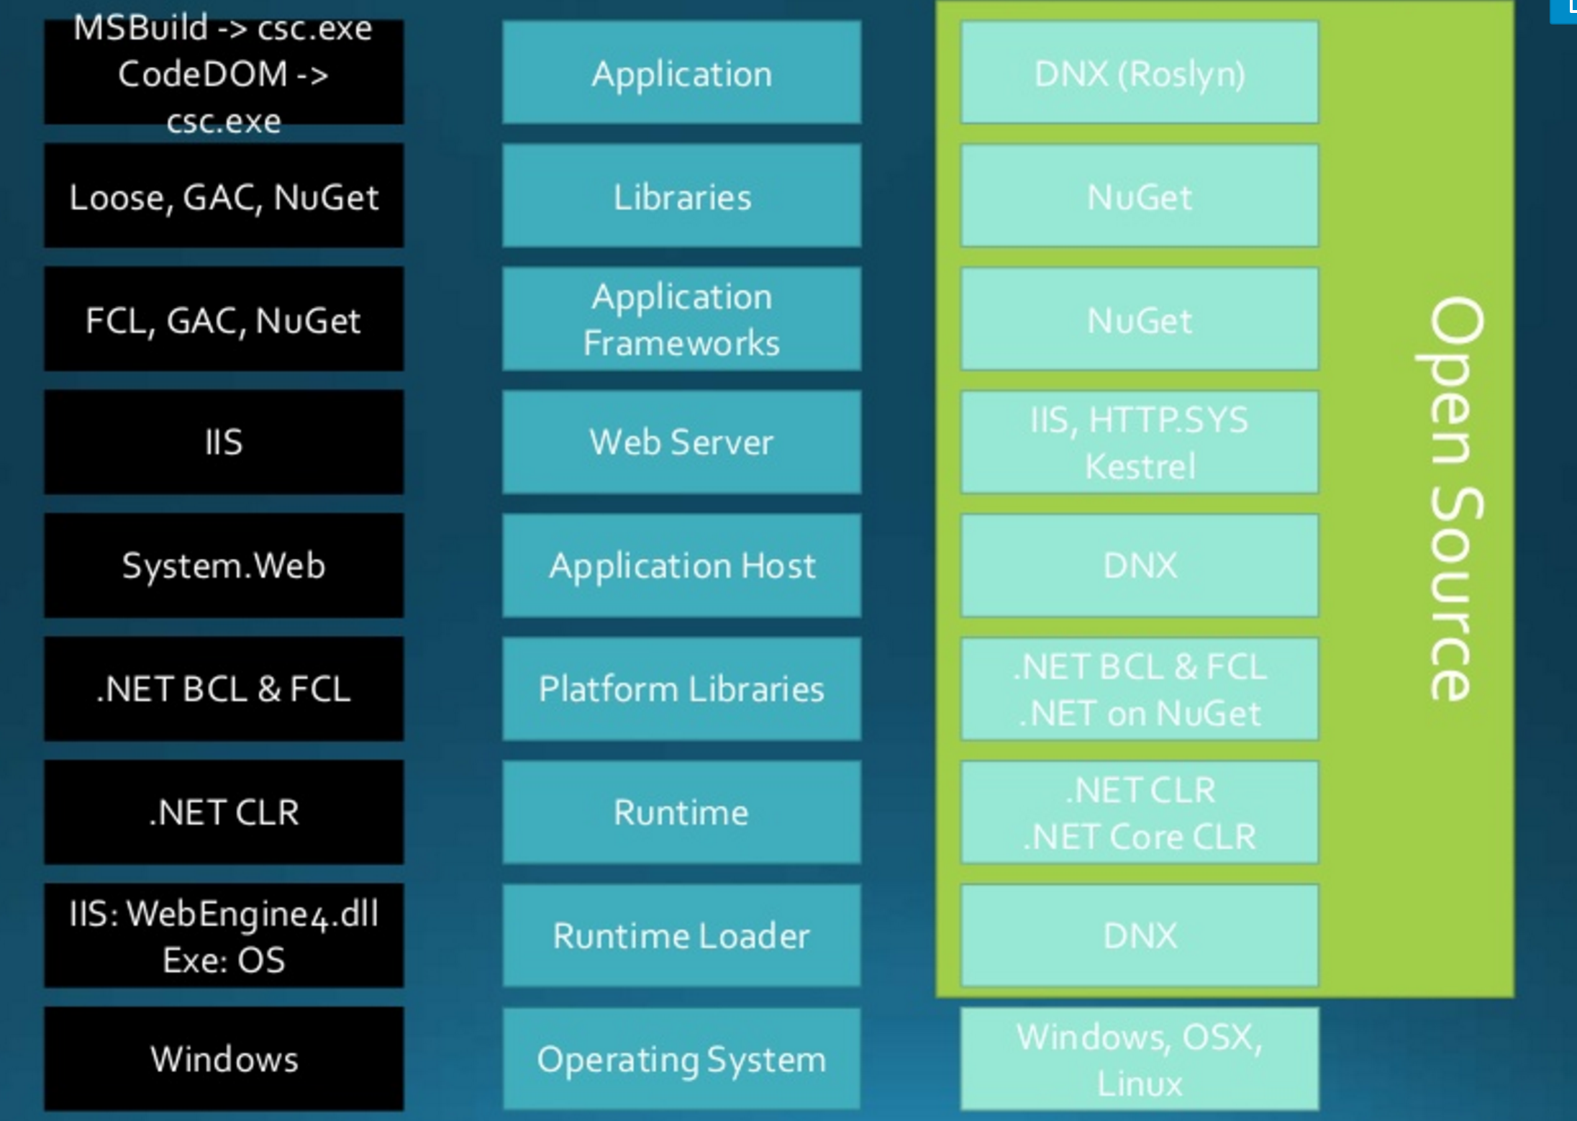
.net vs .net Core 09
Notes:
2 -

Slide 18
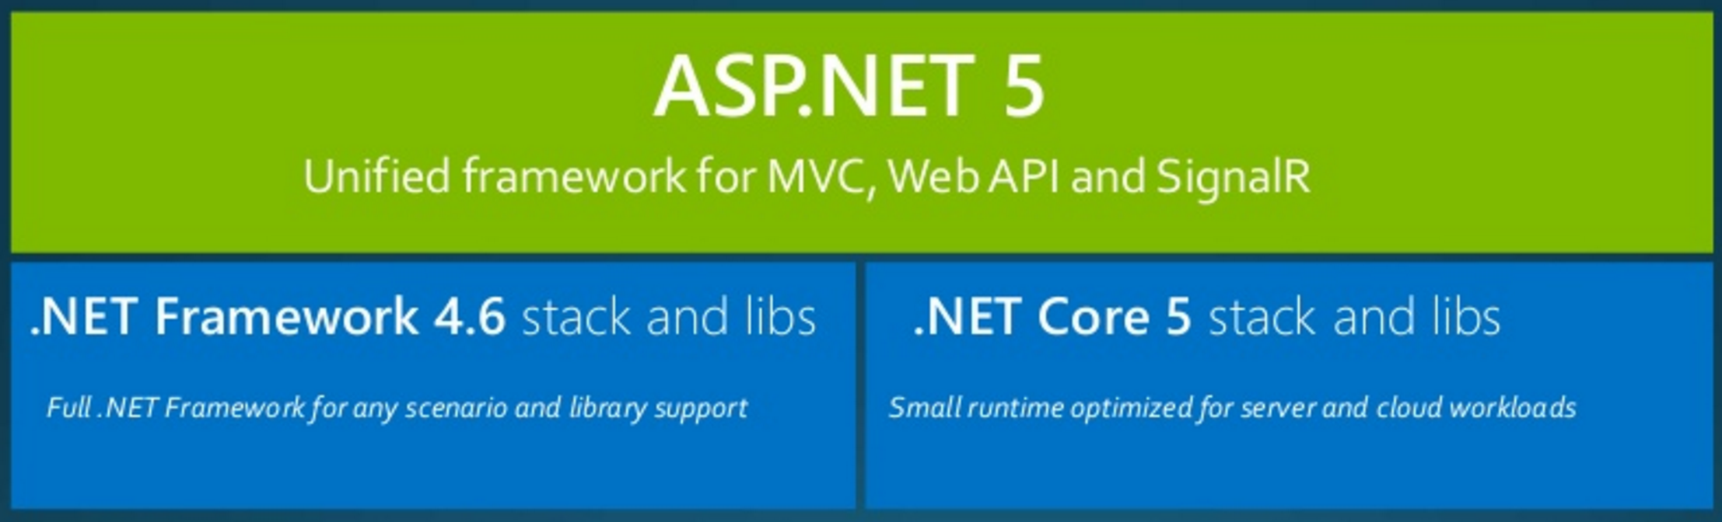
.net vs .net Core 06
Notes:
2 -

Slide 19
.net Core Framework (dotnet.core) 01
.net Core components (Architecture) 01
Runtime CoreCLR or .net Native (AoT, RyuJIT) OSS
Runtime Services GC Garbage Collector, Security
CoreCLI Command Line Interface OSS
CLI – remains ??? Common Language Infrastructure
Notes:
2 -

Slide 20
.net Core Framework (dotnet.core) 02
.net Core components (Architecture) 02
Compiler Roslyn C#, VB
Runtime Native (unmanaged) CoreRT OSS
llilc CIL – Common Intermediate Language to Native Compiler CIL ~ MSIL LLVM based CIL ~ Java ByteCode RyuJIT
Notes:
2 -

Slide 21
Status Current 2016-05 01
CLI dotnet replaces dnvm, dnu, dnx
dnvm - .net Version Manager dnvm upgrade dnvm upgrade –r coreclr dnvm upgrade –r clr dnvm list dotnet restore
dnu - .net Utility – package manager dnu restore dnu publish --runtime dnx-clr-win-x86.1.0.0-rc1 dotnet publish
dnx - .net Execution (Environment) dnx run dotnet run
Notes:
2 -

Slide 22
Status Current 2016-05 02
dotnet vs dnvm, dnu, dnx
docs (quite a lot) still using dnvm, dnu, dnx
EntityFramework 7 -> EntityFramework Core 1 linux - SQLite (2016-02 last time I checked)
Performance impressive
ASP.net Core https://github.com/aspnet/benchmarks Windows still faster than Linux
Notes:
2 -

Slide 23
Status Current 2016-05 03
Modularity
ASP.net Core OWIN – Open Web Infrastructure for .net
Kestrel
libuv
multi-platform support library
focus on asynchronous I/O
It was primarily developed for use by Node.js, also used by Luvit, Julia, pyuv
Notes:
2 -

Slide 24
Status Current 2016-05 03
Modularity
ASP.net Core OWIN – Open Web Infrastructure for .net
Kestrel
libuv
multi-platform support library
focus on asynchronous I/O
It was primarily developed for use by Node.js, also used by Luvit, Julia, pyuv
Notes:
2 -

Slide 25
References / Links
https://dotnet.github.io/
https://github.com/dotnet/core
https://github.com/dotnet/coreclr
https://github.com/dotnet/corefx
https://github.com/dotnet/roslyn
https://github.com/dotnet/cli
https://github.com/dotnet/corert
https://github.com/dotnet/llilc
https://github.com/aspnet/home
https://www.asp.net/vnext
https://docs.asp.net/en/latest/
https://blog.rendle.io/a-guide-to-the-net-projects-on-github/
Notes:
2 -

Slide 26
Q&A
???
Thanks
Notes:
2 -

